Slide 1



Guide to Life-cycle Data Sharing Flow for Transportation Assets
Kick-off meeting
H. David Jeong, Ph.D.
May 12, 2016

Slide 2
Outline
1
Research tasks
Current work in vertical sector
Current workflows in transportation assets
2
3

Slide 3
Proposed research Tasks To Be Performed

Slide 4
Research Tasks
Task 1: Literature review and benchmark the building industry practices
Task 2: Identify business use case narratives and develop process maps
Task 3: Identify data exchange requirements and develop data maps
Task 4: Develop a guide to data and information sharing
Task 5: Final report writing

Slide 5
Task 1-Literature Review/Benchmark the vertical industry
Review publications associated with best practices and lessons learned in data sharing in the vertical industry.
Extensively study the Information Delivery Manual (IDM).
Identify possible areas of adaptations for the civil infrastructure industry.
→ Deliverable: A technical memorandum

Slide 6
Task 2-Identify business use case narratives and develop process maps
Forming workgroup including industry professionals from various disciplines and project phases.
Identify business use cases in which data sharing would occur.
Describe use case narratives in details (actors involved, activities, software applications, project phases, purposes of activities, anticipated outcome).
Translate narratives to process maps using Social Network and/or Business Process Modeling Notation (MPMN).
→ Deliverables: business use case narratives and process maps

Slide 7
Task 3-Identify data exchange requirements and develop data maps
Continue to use focus group discussion
Identify exchange requirements (ERs) for each business use case
Describe ERs in details (data requester, provider, what data attributes, request rationale).
Integrate ERs into Process Maps to develop data sharing maps
→ Deliverables: data exchange requirements and data maps

Slide 8
Task 4 and 5-Develop a guide and prepare a final report
Develop a guidance for DOTs on data sharing during the life cycle of transportation assets.
Hold a workshop/seminar to disseminate the project findings.
Develop a final report documenting the research results.
→ Deliverables: A guidebook and a final report.

Slide 9
Data sharing guidance in vertical sector Information Delivery Manual (IDM)

Slide 10
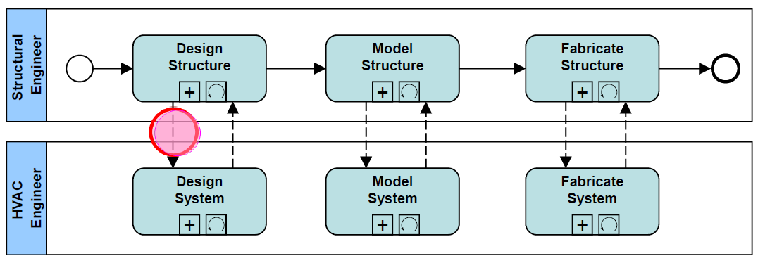
Process Map
A process map describes:
Tasks (activities) to be performed.
Sequencing of tasks.
Actors (people/organizations) involved.
Credit: buildingSMART

Slide 11
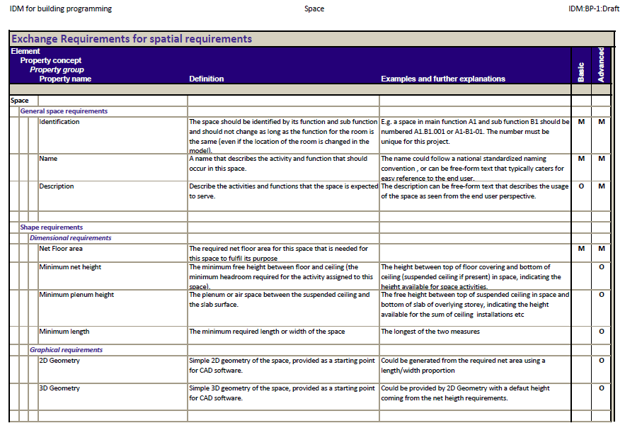
Exchange Requirement (ER)
ER defines what data/information to be shared.
Audience is the user (architect, engineer, constructor, etc.)
(Credit: buildingSMART)

Slide 12
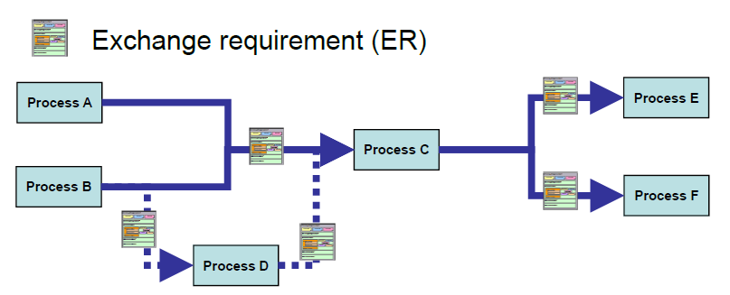
IDM-ER in Process Map
This is an integrated map of process and exchange requirements,
This map shows what data to be shared to whom and when.
(Credit: buildingSMART)

Slide 13
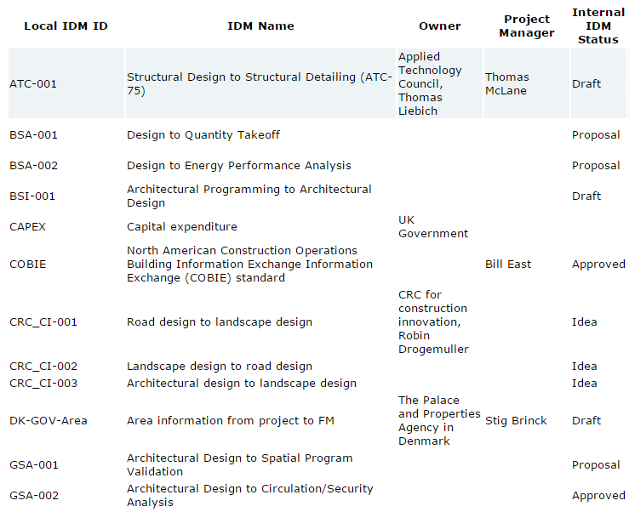
Overview of IDM projects
04 Approved
01 Under review
12 Draft
18 Work in progress
06 Proposal
The full list can be found at: http://iug.buildingsmart.org/idms/overview

Slide 14
Current workflows in Civil Infrastructure Assets

Slide 15
Culvert workflow
Pre-construction survey
Construction survey
Surveyor
1
Designer
Cross-section design
2
5
Flow line design
3
Hydraulics
Contractor
4
Installation
1
Survey data
Locates of existing culverts
Locations of draw
2
Survey data
Design cross-section
3
Flow lines
4
Survey data
Storm sewer
5
Adjustments

Slide 16
Guardrail workflow
Prelim survey
Surveyor
1
Designer
Replacement decision making
2
Installation
3
Contractor
Inspector
4
Inspection
Inspection
1
Map of what exist
Goepack file
Micorstation line work
2
Guardrail type
Length, location, stationing, etc.
Microstation files
3
4
Guardrail condition
Sta references, locations, site time, contract progress, material

Slide 17
THANK YOU!
Q&A

